Slide 1
Welcome To Our Presentation

Slide 2
Course Name : Software Development Project-II Course Code : CSE - 3116
Presented By
Sagor Sarker
CE – 19004
Session – 2018-19
Department Of CSE
MBSTU.
Supervisor
Dr. Md. Sazzad Hossain
Professor
Department Of CSE
MBSTU.

Slide 3
Presentation on
Cricket Scoresheet

Slide 4
Contents
Introduction
Objective
Purpose
Developing Tools
Features
Use Case Diagram
Sequence Diagram
Class Diagram
Project View
Limitations
Conclusion and future works

Slide 5
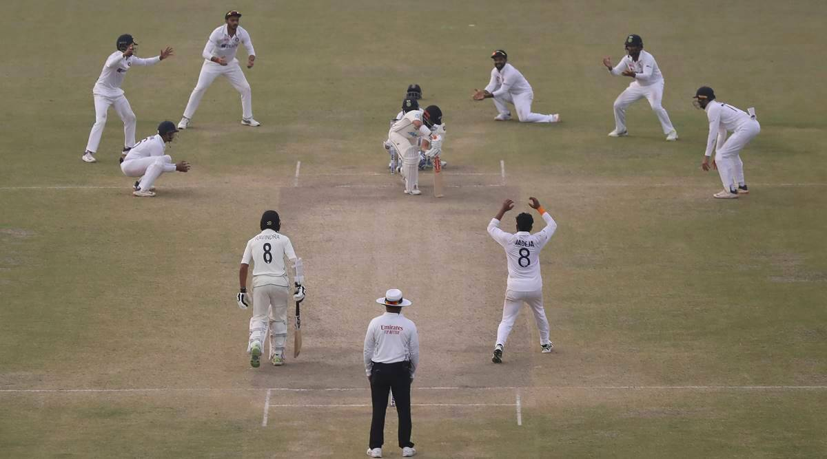
Isn’t it annoying to remember the result and update it in your mind? What if someone counts the score for you!!!

Slide 6
Introduction
Cricket scoresheet is a C++ console based application which counts the every possible result of a cricket game.
Multiple window application run by codeblocks.
User need to have basic idea about cricket game.
User can update the result in every ball and anyone can see the scoreboard or the full score anytime.

Slide 7
Objective
Calculating the result of a cricket match is hard. A cricket match consists of many parameters like total run,over,wicket,batter run etc.Simultaneously keeping track of those information is quite impossible.This project helps us to store and show those information effectively and efficiently.

Slide 8
Purpose
To save time and memory.
Make the game more enjoyable.

Slide 9
Developing Tools
Operating System: Windows 7,8,10,11
Language: C++
Application : Notepad,Chrome
Database: File system
Platform: Code Blocks

Slide 10
Features
Game details window : Is asks for the basic info about the match like (venue,
match between teams,over) etc.
Playing eleven teams and players : It shows the two teams and playing
eleven players.
Toss and toss decision : New window appears where teams chooses head or tail and
winner team chooses whether to bat or ball.
Choose batter : Initially choose striking and non-striking batter and one batter
when a player gets out.
Game : Calculates the result ball by ball and updates the info in a very short time.
Show result : When both innings are over it shows the result which team wins by runs
or wickets or the match is tied.

Slide 11
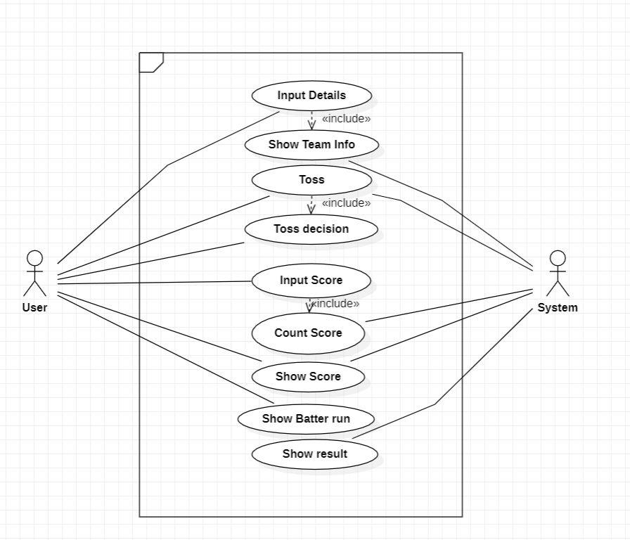
Use Case Diagram

Slide 12
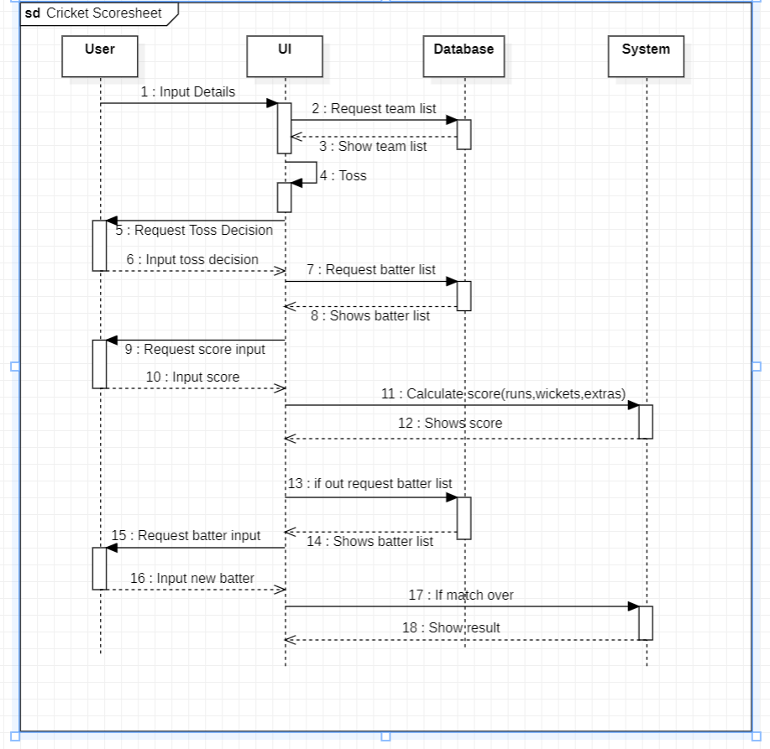
Sequence diagram

Slide 13
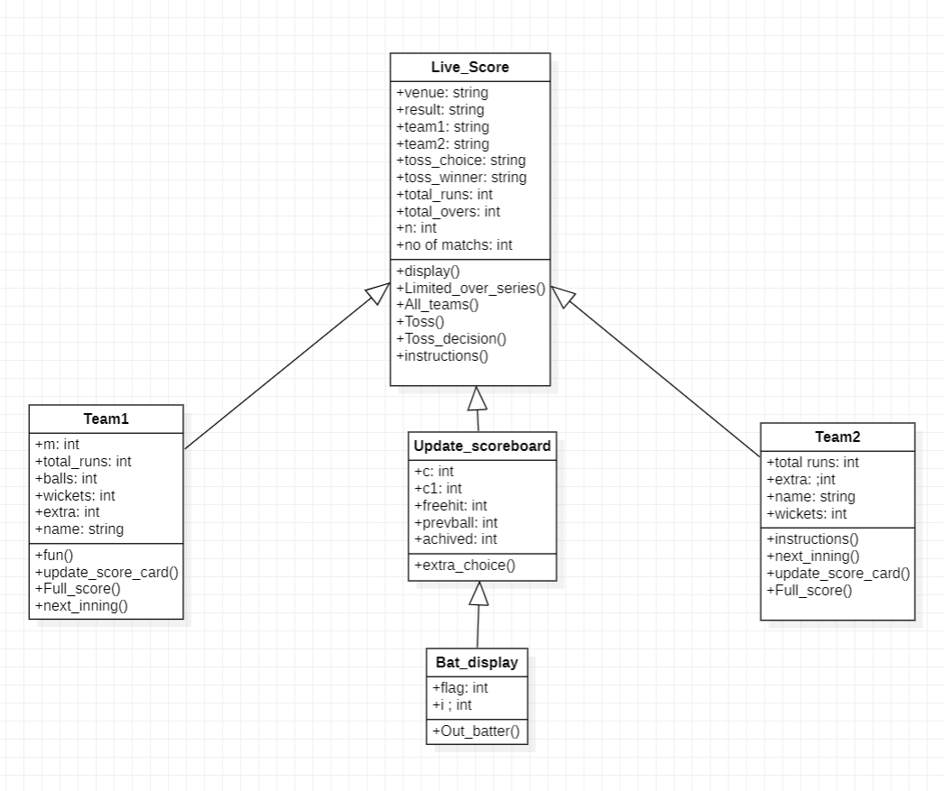
Class Diagram

Slide 14
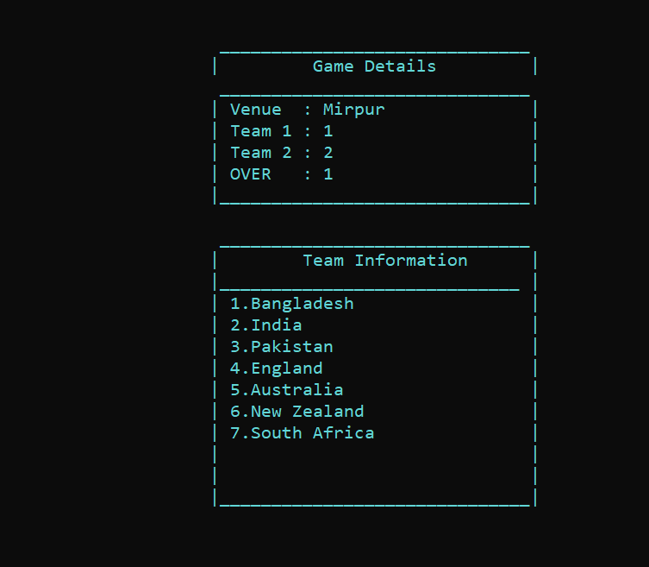
Game details

Slide 15
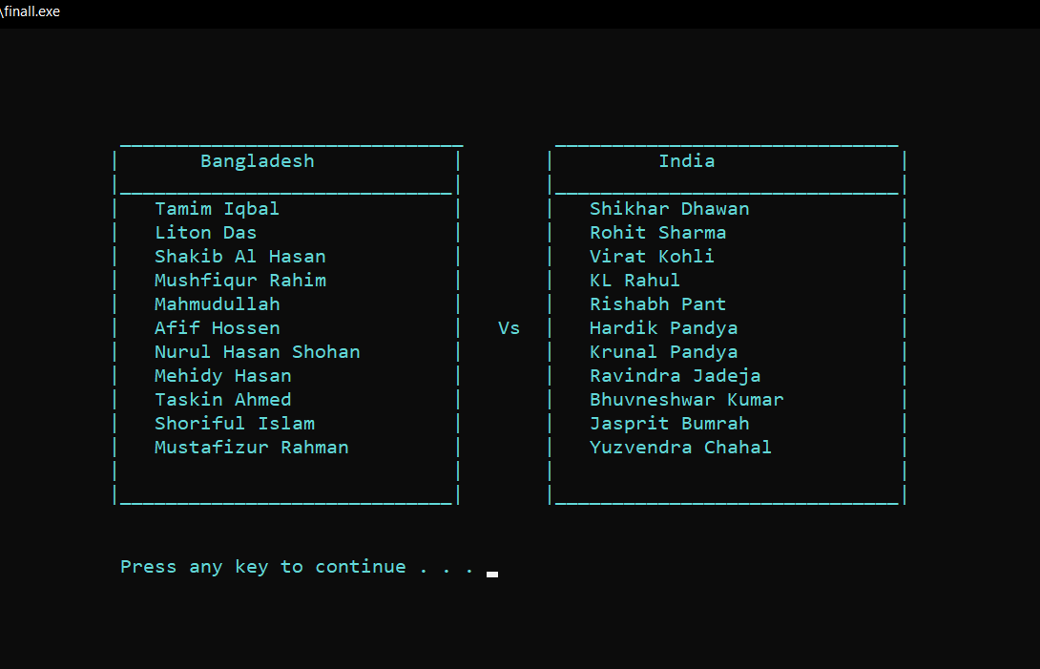
Showing Teams And Players

Slide 16
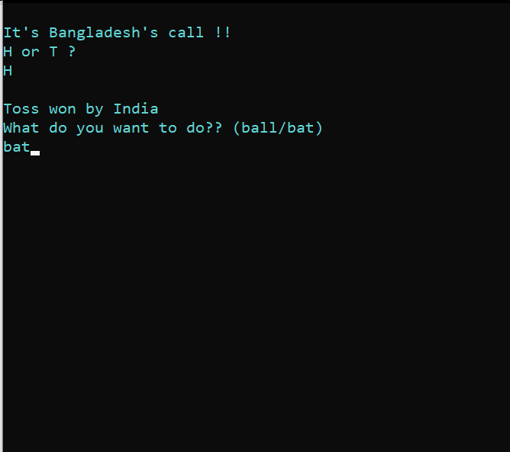
Toss Time

Slide 17
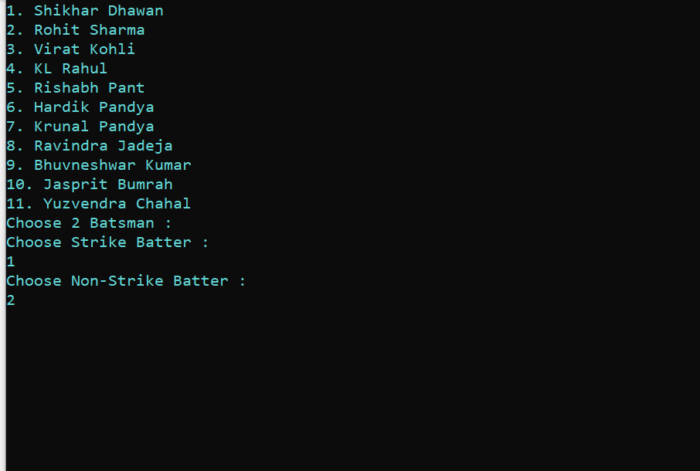
Choose Batter

Slide 18
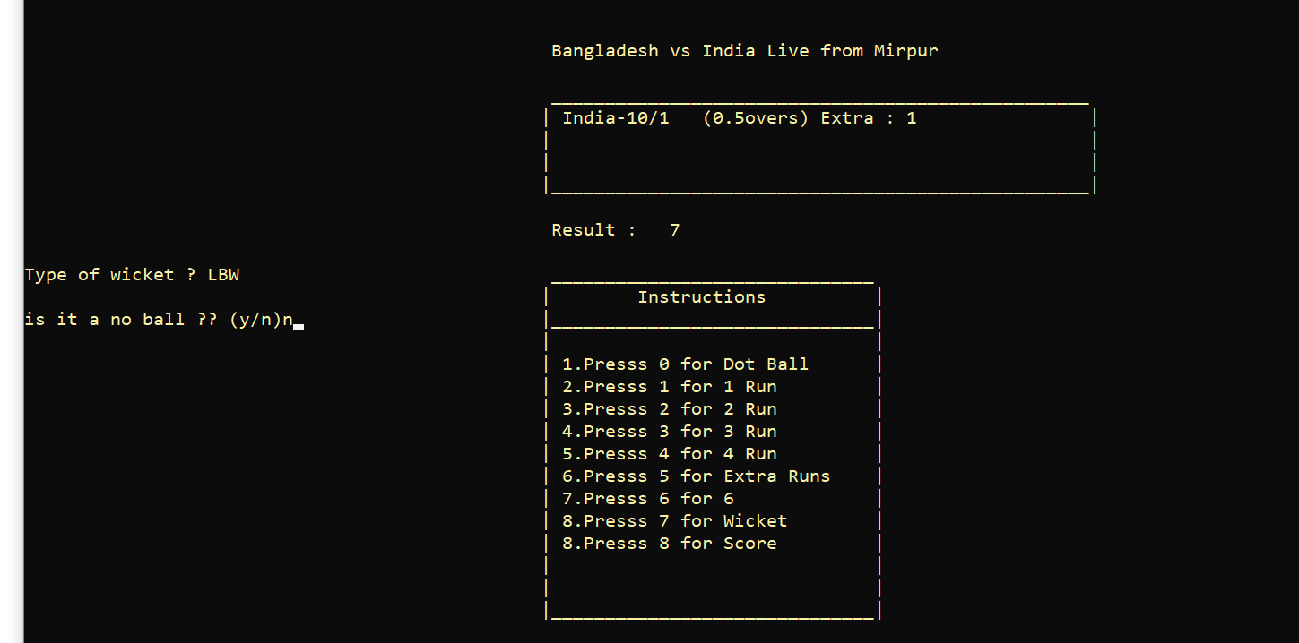
Scoreboard

Slide 19
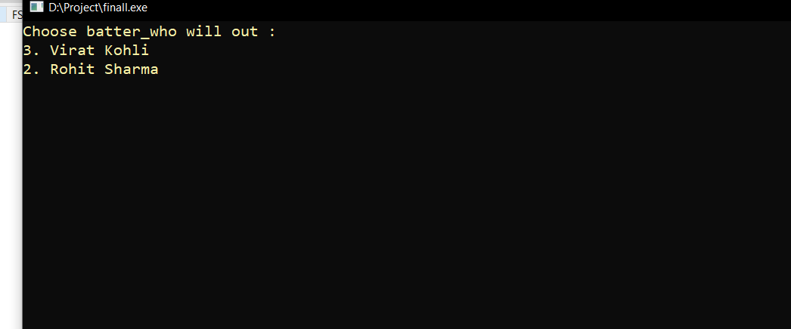
Who is out!

Slide 20
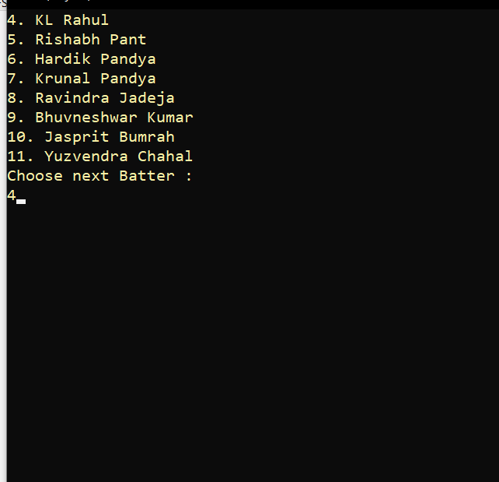
Next Batter

Slide 21
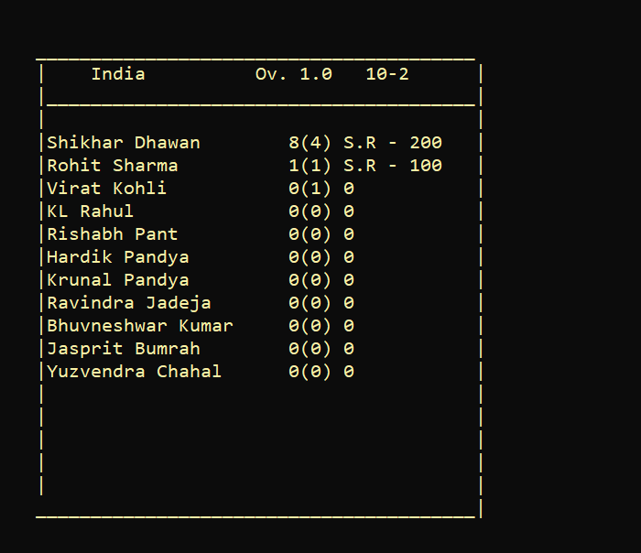
1st innings scoresheet

Slide 22
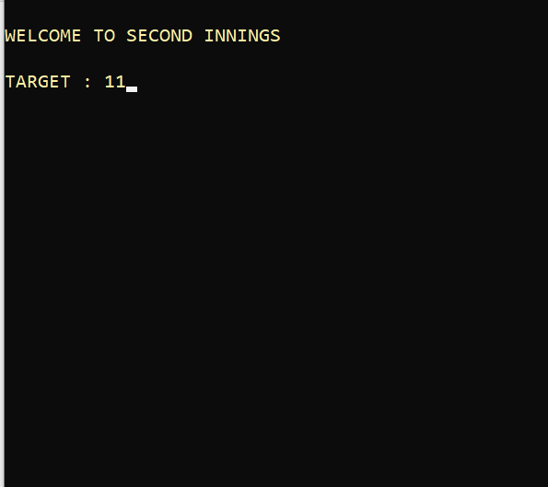
Target window

Slide 23
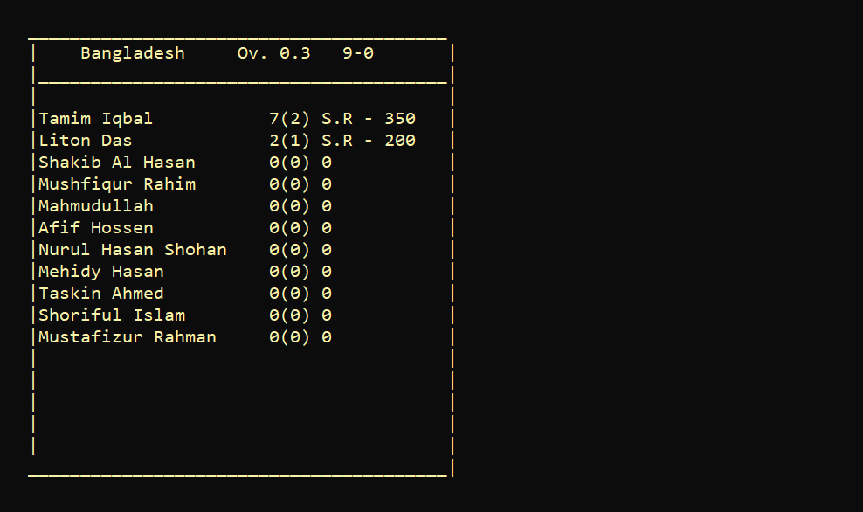
Check scoresheet anytime!

Slide 24
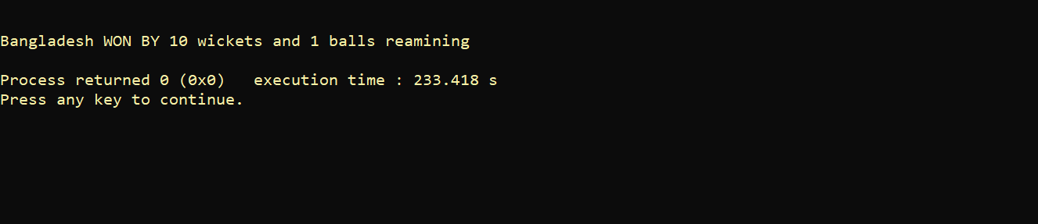
Final Result

Slide 25
Limitations
Cricket is a game of thousand possibilities. I tried to cover maximum possible ways of
result but its very hard to cover all.
Baller information is not available.
Many country plays cricket. All of them is not available.

Slide 26
Conclusion And Future Works
In this work, the console based C++ program is made with the help of basic data structure and algorithm which meets the requirments easily.
The system we have developed is fully responsive in desktop devices but not fully responsive in mobile devices.
It is a flexible and very user friendly system.
We will make some future improvement in our cricket scoresheet project. We have plans to make a web based and android applications in future.

Slide 27
Thank You…

